Slide 1
<Project Name>
24-880 AI Agents for Engineers
<Group Member Name(s)>
<Presentation Date>
Notes:
Hi everyone,
Thank you for attending my Thesis Proposal
Today I’ll be talking about
[READ TITLE]
I’d first like to thank my thesis advisor
Dr. Amir Barati Farimani
For all of his mentorship and guidance
I’d also like to thank the members of my thesis committee
Dr. Anthony Rollett
Dr. Jonathan Malen
Dr. Sneha Narra
For accepting my committee invitation.
Alright, let’s get started.

Slide 2
Background

Slide 3
Problem Statement

Slide 4
Methodology

Slide 5
Results

Slide 6
Discussion

Slide 7
Conclusion

Slide 8
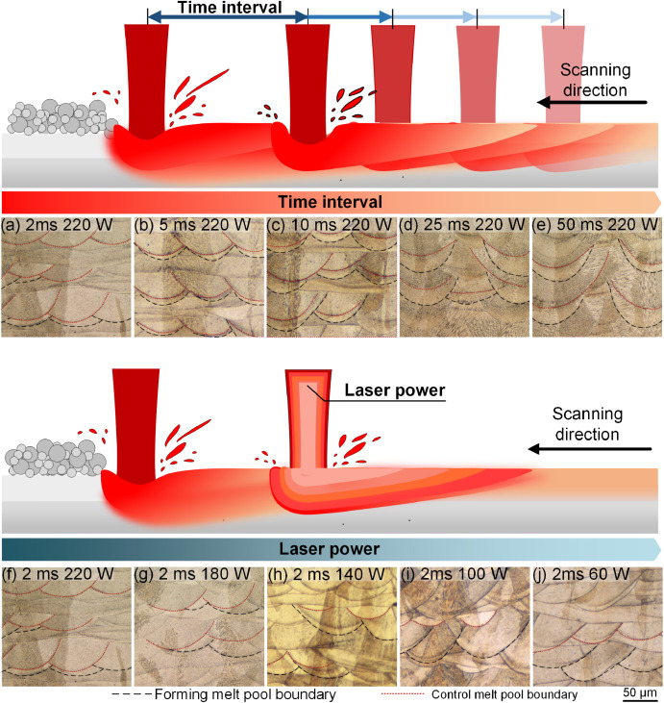
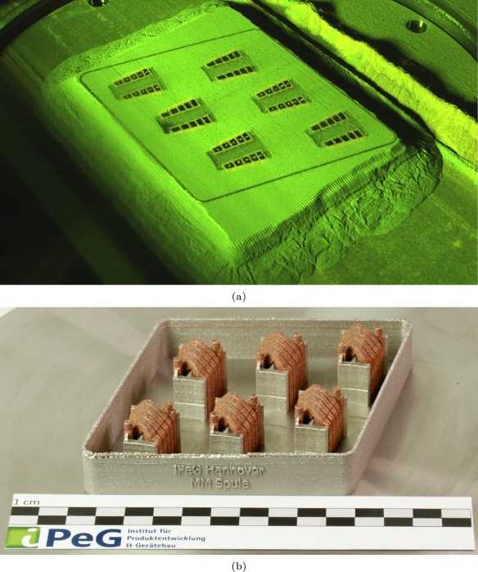
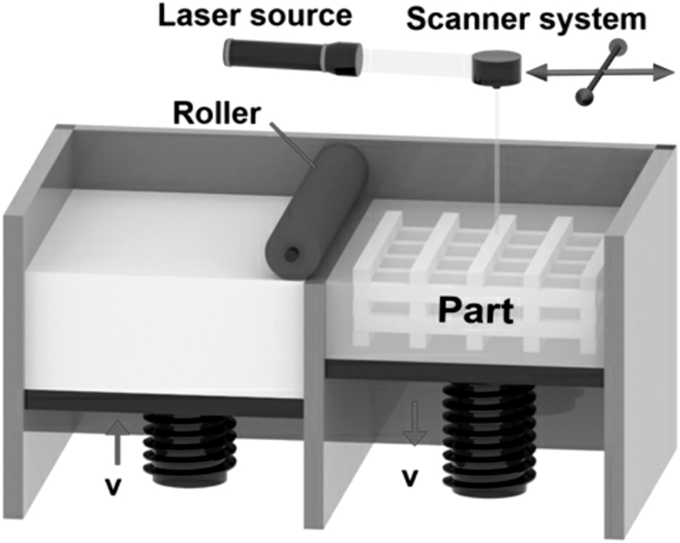
Example Slide
Laser Powder Bed Fusion (LPBF) ^{[a]}
Multi-laser LPBF ^{[b]}
Multi-material LPBF ^{[c]}
[a] Zhao, et al. Laser powder bed fusion of powder material: A review, 3D Printing and Additive Manufacturing, 2023
[b] Wang, et al. Effect of dual-laser powder bed fusion on surface quality, internal defects and properties of 316L stainless steel, Additive Manufacturing, 2023
[c] Oel, et al. Multi-material laser powder bed fusion additive manufacturing of concentrated wound stator teeth, Additive Manufacturing Letters, 2023
Notes:
Additive manufacturing, specifically laser powder bed fusion, is a multi-faceted complex process that is becoming more complex with advances such as multi-laser and multi-material based approaches.

